Slide 1
MQP Progress 9/2/21
Ryan Astor, Kyle Costello, Josh DeOliveira, Alek Lewis

Slide 2
Accomplishments
Each of our team members have:
Watched Anaconda tutorial
Installed Anaconda
Read original GAN paper

Slide 3
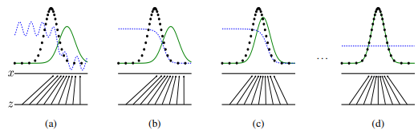
Original GAN Paper
GANs consist of a Generator (G) and a Discriminator (D)
G attempts to map random noise to the real distribution
D attempts to discriminate between the real distribution and G’s output
So long as D never overfits, G should iteratively converge towards the real distribution
[0] Goodfellow, Ian et. al. “Generative Adversarial Nets”

Slide 4
Original GAN Paper cont.
Simple GAN strengths:
Should work with most possible functions
Simple GAN weaknesses:
Training is difficult (cannot train either model too much without training the other, or it’ll cause overfitting)
The generator can’t generate anything which exists outside of the known data (if you only have pictures of wolves on snow, you can’t generate wolves on grass!)

Slide 5
Tensors
Data structure designed to be used efficiently with GPUs and TPUs
Used to encode the input and output of data
Tensors can be initialized in several ways:
Directly from data
From a NumPy array
From another tensor
With random or constant variables
Tensors contain information about what computations created them - the Computation Map
PyTorch, “Tensors”, https://pytorch.org/tutorials/beginner/basics/tensorqs_tutorial.html
Notes:
Ryan

Slide 6
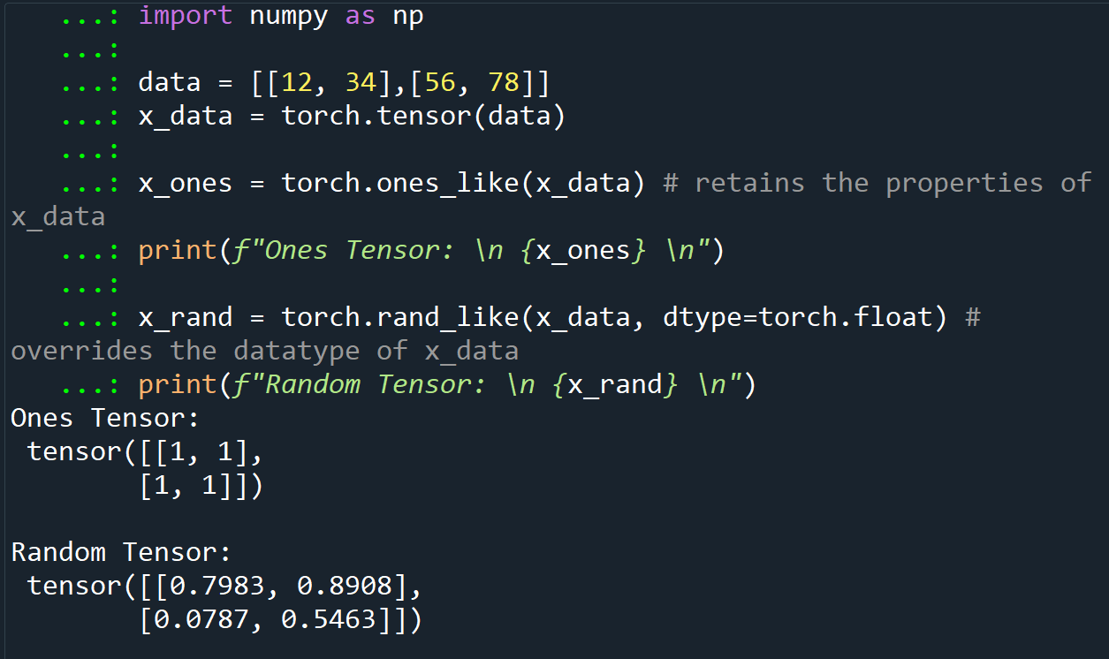
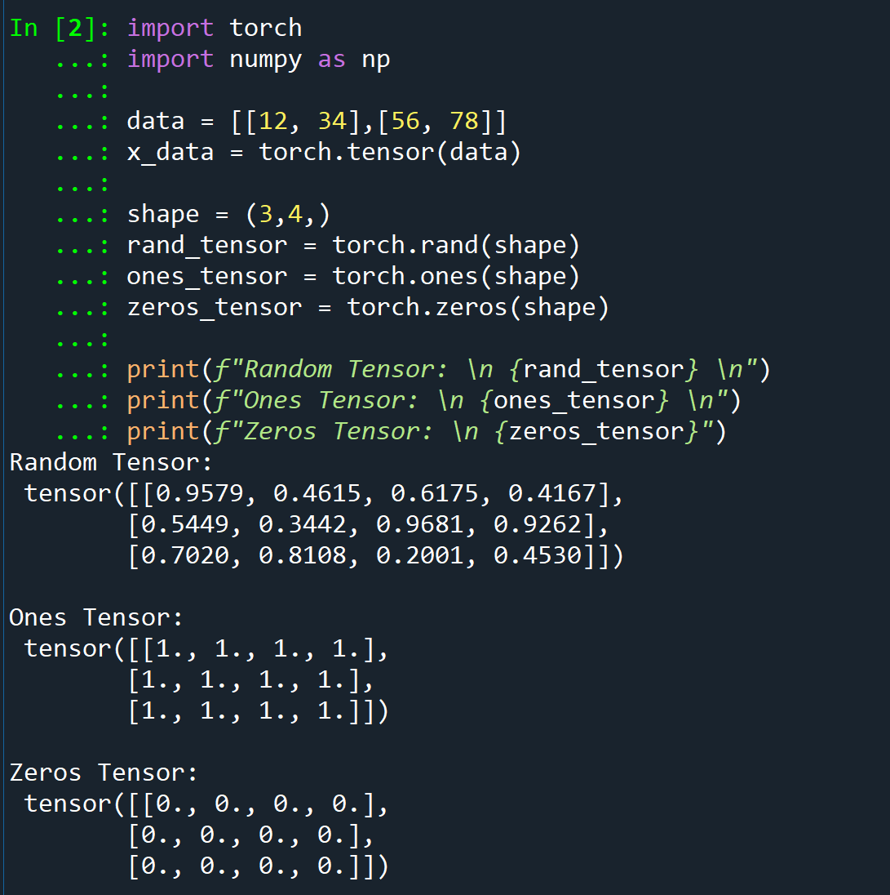
Tensors
Notes:
Ryan

Slide 7
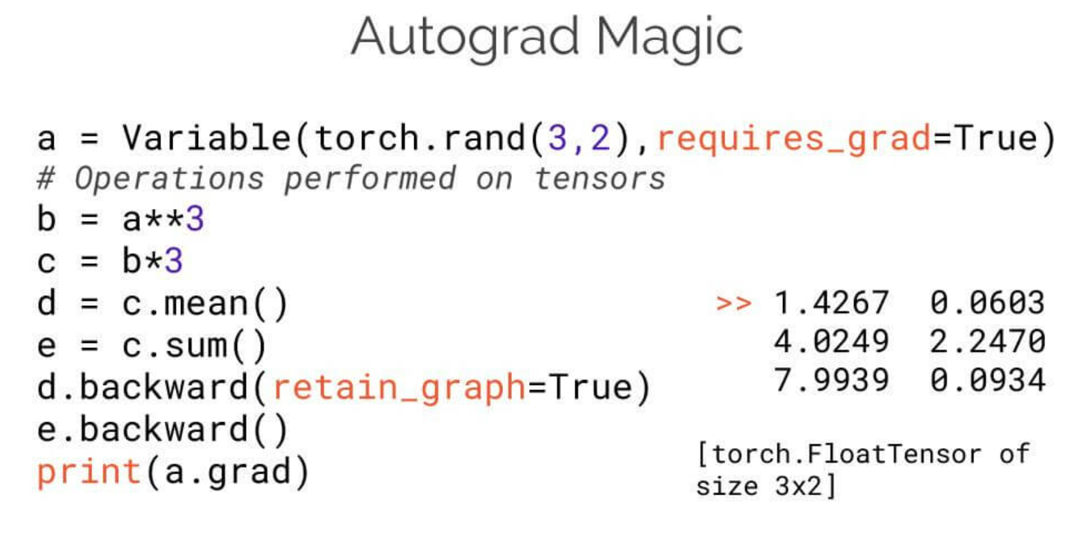
torch.autograd
torch.autograd helps a neural network train
Conceptually, it keeps track of data (tensors) in a directed acyclic graph consisting of Function objects
Involved in forward and backward passes
PyTorch, “A Gentle Introduction to torch.autograd”, https://pytorch.org/tutorials/beginner/blitz/autograd_tutorial.html#sphx-glr-beginner-blitz-autograd-tutorial-py
https://info.algorithmia.com/test-import-blog/exploring-the-deep-learning-framework-pytorch
Notes:
Kyle

Slide 8
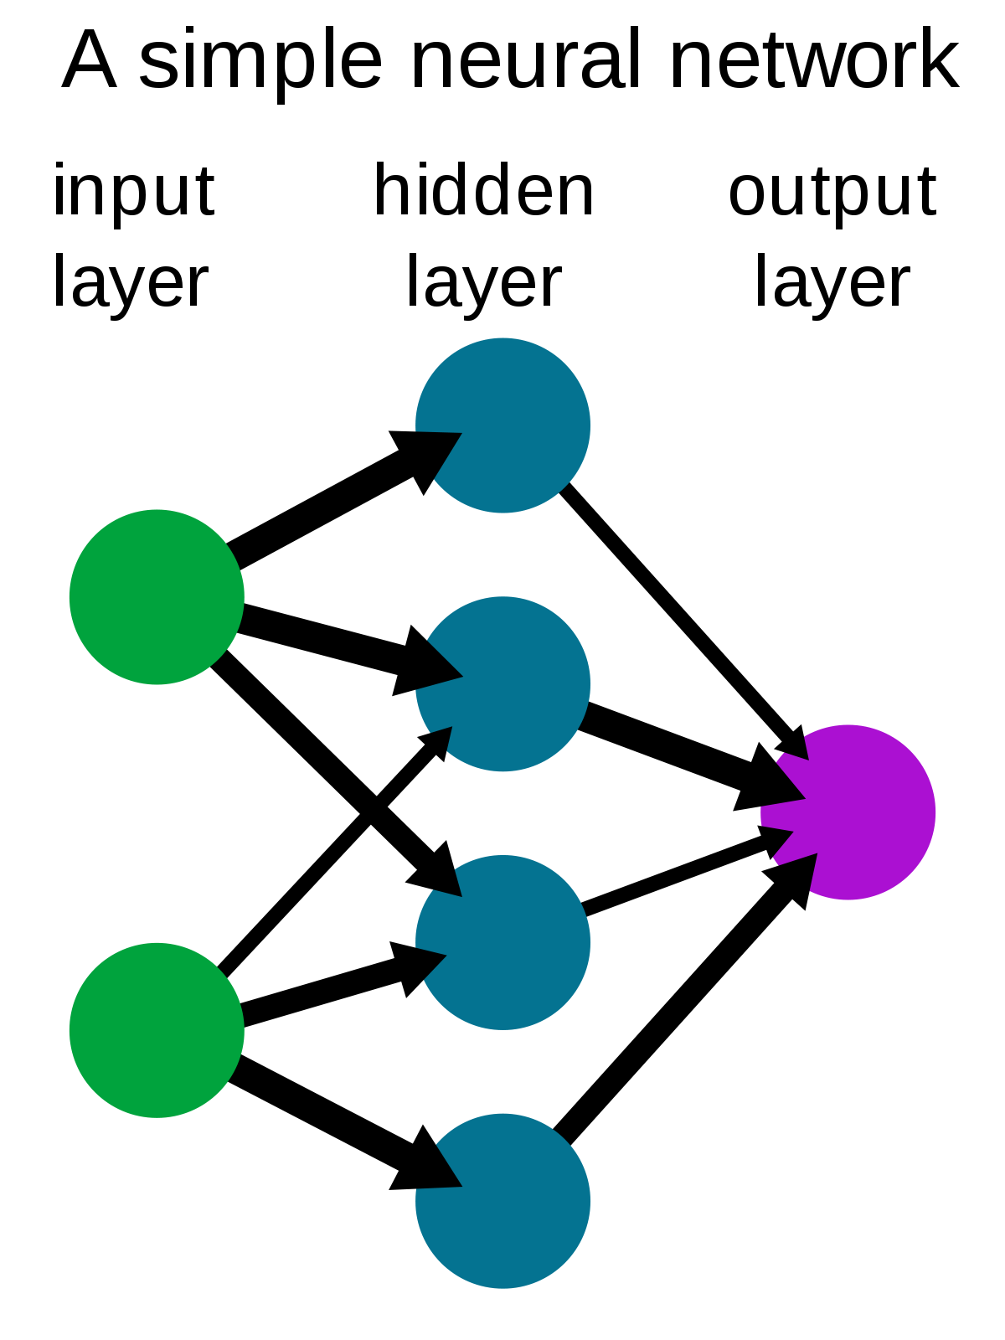
Neural Networks
Neural Networks (NNs) are nested functions that get executed on data input
Defined in parameters (weights and biases) which are stored in tensors
Training a Neural Network happens in two steps:
Forward Propagation - NN makes educated guess about the correct input
Backward Propagation - NN adjusts parameters in proportion to the error in its guess
Traverses backwards from output
Collects derivatives of the error with respect to parameters (gradients)
Optimizes the parameters using gradient descent
https://en.wikipedia.org/wiki/Neural_network
PyTorch, “Neural Networks”, https://pytorch.org/tutorials/beginner/blitz/autograd_tutorial.html#sphx-glr-beginner-blitz-autograd-tutorial-py
Notes:
Kyle

Slide 9
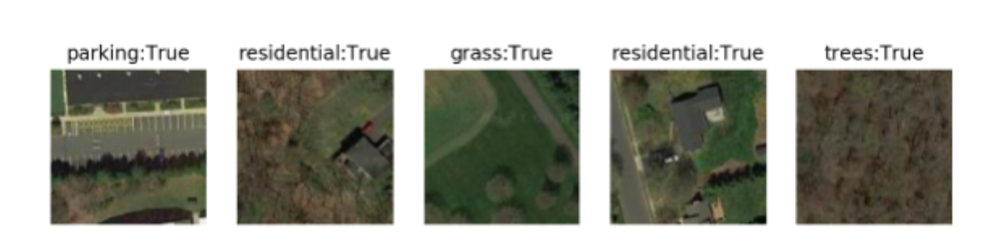
Training a Classifier
Load and normalize particular datasets with torchvision
Define a Neural Network (CNN, RNN, etc.)
Define a loss function
Train the network on training data
Test the network on testing data
PyTorch, “Training a Classifier”, https://pytorch.org/tutorials/beginner/blitz/cifar10_tutorial.html#sphx-glr-beginner-blitz-cifar10-tutorial-py
Notes:
Kyle

Slide 10
Conventional GAN Training
Alternate training by freezing each machine for a static number of epochs
5/2 Training Ratio
Discriminator
Generator
Discriminator
Generator
Discriminator
...
Trains
Trains
Trains
Trains
Trains
5 Epochs
2 Epochs
5 Epochs
2 Epochs
5 Epochs
[1] Lim et al. “Geometric GAN”
[2] Lin, Muyang et. al “GAN Compression: Efficient Architectures for Interactive Conditional GANs”
[3] Lei, Kai et. al “GCN-GAN: A Non-linear Temporal Link Prediction Model for Weighted Dynamic Networks”
[4] Lee, Hyeungill et. al “Generative Adversarial Trainer: Defense to Adversarial Perturbations with GAN”
[5] Mescheder, Lars et. al “Which Training Methods for GANs do actually Converge?”
[6] Gao, Lianli et. al “Lightweight dynamic conditional GAN with pyramid attention for text-to-image synthesis”
[7] Mirza Mehdi, “Conditional Generative Adversarial Nets”
[8] Lee, Minhyeok et. al, “Controllable Generative Adversarial Network”
[9] Goodfellow et. al, “Generative Adversarial Nets”
[10] Shoshan et. al , “GAN-Control: Explicitly Controllable GANs”

Slide 11
Conventional GAN Training
Original Motivation
Flaws
Stable training is an open problem
Alternates training
Simple to implement
Involves only 2 hyper-parameters
Ensures D is always better than G
D can be overtrained
Leads to inefficient computation
Minority of epochs spent training G
Doesn’t maintain a sense of fair competition between machines

Slide 12
Proposed Method: Dynamic Training
Phase 1: Conventional training for first T epochs
D
G
D
G
D
G
...
Phase 2: Train D until model yields minimum recall R
...
D
...
Phase 3: Switch which machine to train based on fpR w.r.t PL/PU
G
D
G
D
G
...

Slide 13
Proposed Method: Dynamic Training
Assumptions:
Similar runtimes for training
Limited time or resources
No known “good” epoch ratio
Real data has some diversity
D can achieve a high recall
G has adequate complexity
Additional hyperparameters:
Phase 1 length, T ∈ ℕ
Recall threshold, R ∈ (0, 1)
Push Threshold, PU ∈ (0, 1)
Pull Threshold, PL ∈ (0, 1)
D training interval
G training interval
G(z) at an epoch
False Positive Rate of D(G(z)) During Phase 3 Training
1.00
PU
fpR
Pull/Push Margin
PL
0
Epoch

Slide 14
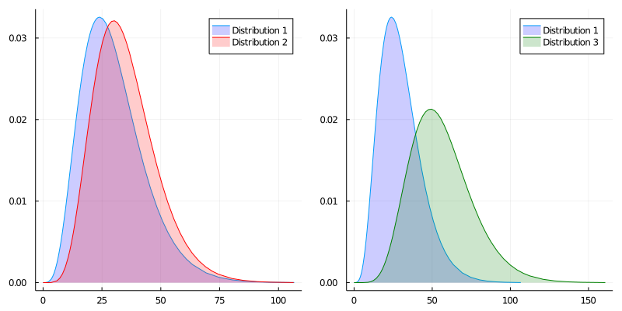
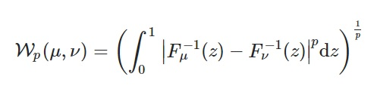
Measuring Convergence: Wasserstein Distance
Metric for dissimilarity between two 1-D probability distributions
Range: [0,∞) fewer = more similar
Plots courtesy of Medium.com “Entropy” https://medium.com/analytics-vidhya/a-primer-of-entropy-information-and-kl-divergence-42290791398f

Slide 15
Evaluating Convergence
What usually happens
What we want to happen
Wasserstein Distance
Wasserstein Distance
Training Time
Training Time
Modification of Figure by Walter Gerych

Slide 16
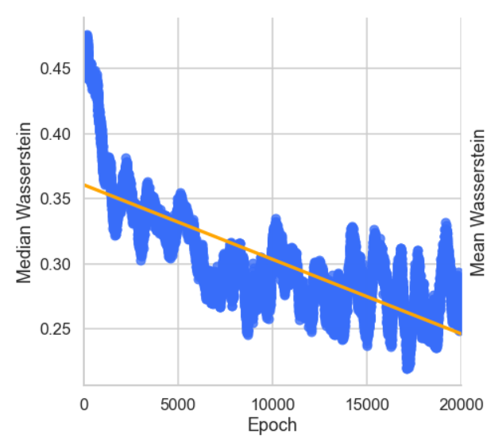
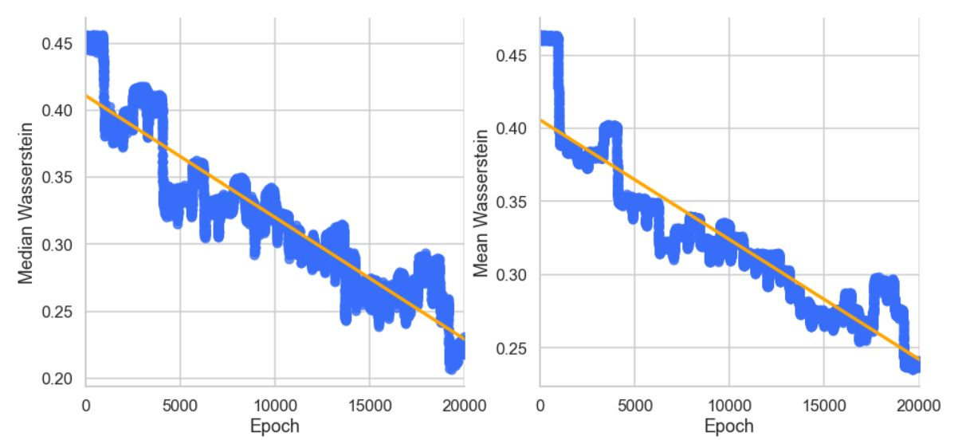
Prelim. Results: Median Wasserstein
Conventional Training
Dynamic Training

Slide 17

Prelim. Results: Mean Wasserstein
Conventional Training
Dynamic Training

Slide 18
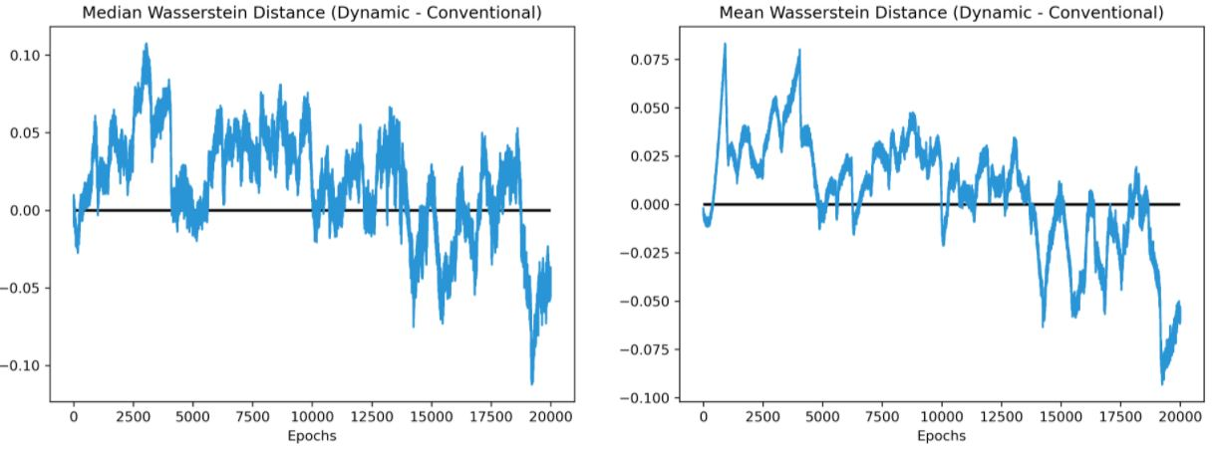
Prelim. Results: Wasserstein Difference
Negative means dynamic approach performed better that epoch

Slide 19

Demo

Slide 20
How Does This Add Value?
Improves training stability
Less variance in loss
Reduces frequency of redundant/inefficient epochs
Only trains a machine to stay competitive with adversary
Negligibly additional complexity for implementing
O(n) complexity w.r.t. volume of real data
Maximizes training of G
Doesn’t need to adhere to an epoch ratio > 1
Leads to equal to or quicker convergence (empirically)

Slide 21
What’s Left?
Extensive set of experiments
Results on vanilla GAN, controllable GANs, etc
Generalization of code to work for other architectures
Creating easily usable PyTorch package
Theoretical analysis of method
Any provable claims?
Improvements to method
Are all 3 phases necessary?
Other new training strategies

Slide 22
Takeaways
Pytorch and Anaconda are effective packages/tools for implementing ML and data science applications in python.
Simple GANs are a relatively new ML approach in which models learn by competing adversarially.
Dynamic training is a novel approach to solving unstable training in GANs.
Dynamic training demonstrates strong efficacy as a superior training methodology when tested in preliminary settings.

